Slide 1
C#

Slide 2
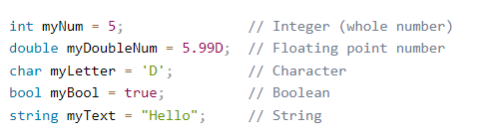
Data Types
A variable in C# must be a specified data type

Slide 3
Data Types
A data type specifies the size and type of variable values.
It is important to use the correct data type for the corresponding variable; to avoid errors, to save time and memory, but it will also make your code more maintainable and readable. The most common data types are:

Slide 4
Data Types
Data Type | Size | Description
int | 4 bytes | Stores whole numbers from -2,147,483,648 to 2,147,483,647
long | 8 bytes | Stores whole numbers from -9,223,372,036,854,775,808 to 9,223,372,036,854,775,807
float | 4 bytes | Stores fractional numbers. Sufficient for storing 6 to 7 decimal digits
double | 8 bytes | Stores fractional numbers. Sufficient for storing 15 decimal digits
bool | 1 bit | Stores true or false values
char | 2 bytes | Stores a single character/letter, surrounded by single quotes
string | 2 bytes per character | Stores a sequence of characters, surrounded by double quotes

Slide 5
Numbers
Number types are divided into two groups:
Integer types stores whole numbers, positive or negative (such as 123 or -456), without decimals. Valid types are int and long. Which type you should use, depends on the numeric value.
Floating point types represents numbers with a fractional part, containing one or more decimals. Valid types are float and double.

Slide 6

Integer Types - int
The int data type can store whole numbers from -2147483648 to 2147483647.
In general, the int data type is the preferred data type when we create variables with a numeric value.

Slide 7

Integer Types - long
The long data type can store whole numbers from -9223372036854775808 to 9223372036854775807.
This is used when int is not large enough to store the value. Note that you should end the value with an "L":

Slide 8


Floating Point Types
A floating-point data type is used to store a number with a decimal, such as 9.99 or 3.14515.
The float and double data types can store fractional numbers. Note that you should end the value with an "F" for floats and "D" for doubles:
Float example
Double example

Slide 9
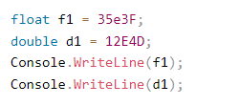
Scientific Numbers
A floating-point number can also be a scientific number with an "e" to indicate the power of 10:

Slide 10
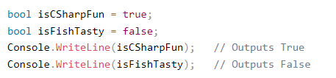
Booleans
A boolean data type is declared with the bool keyword and can only take the values true or false.
Boolean values are mostly used for conditional testing, which you will learn more about in a later chapter.

Slide 11

Characters
The char data type is used to store a single character.
The character must be surrounded by single quotes, like 'A' or 'c':

Slide 12

Strings
The string data type is used to store a sequence of characters (text).
String values must be surrounded by double quotes:

Slide 13
Type Casting
Type casting is when you assign a value of one data type to another type.
In C#, there are two types of casting:
Implicit Casting (automatically) - converting a smaller type to a larger type size
char -> int -> long -> float -> double
Explicit Casting (manually) - converting a larger type to a smaller size type
double -> float -> long -> int -> char

Slide 14
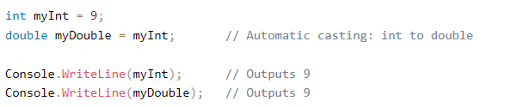
Implicit Casting
Implicit casting is done automatically when passing a smaller size type to a larger size type:

Slide 15
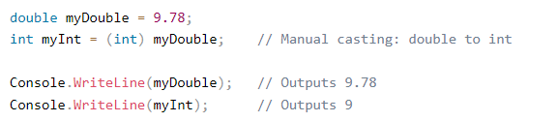
Explicit Casting
Explicit casting must be done manually by placing the type in parentheses in front of the value:

Slide 16
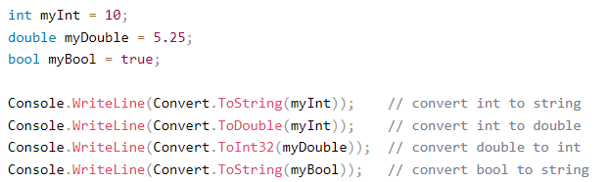
Type Conversion Methods
It is also possible to convert data types explicitly by using built-in methods,
such as Convert.ToBoolean, Convert.ToDouble, Convert.ToString, Convert.ToInt32 (int) and Convert.ToInt64 (long).

Slide 17
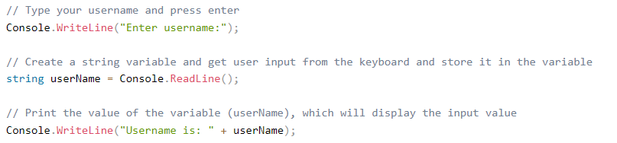
User Input
Get User Input
Use Console.ReadLine() to get user input.
The user can input username, which is stored in the variable userName. Then print the value of userName.

Slide 18
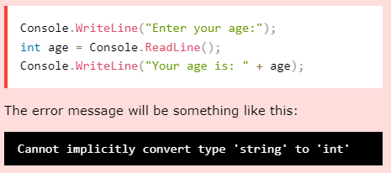
User Input and Numbers
The Console.ReadLine() method returns a string.
Therefore, you cannot get information from another data type, such as int. The following program will cause an error:

Slide 19

User Input and Numbers
Like the error message says, you cannot implicitly convert type 'string' to 'int'.

Slide 20


Operators
Operators are used to perform operations on variables and values.
In the example below, we use the + operator to add together two values:
Although the + operator is often used to add together two values, like in the example above, it can also be used to add together a variable and a value, or a variable and another variable:

Slide 21
Arithmetic Operators
Operator | Name | Description | Example
+ | Addition | Adds together two values | x + y
- | Subtraction | Subtracts one value from another | x – y
* | Multiplication | Multiplies two values | x * y
/ | Division | Divides one value by another | x / y
% | Modulus | Returns the division remainder | x % y
++ | Increment | Increases the value of a variable by 1 | x++
-- | Decrement | Decreases the value of a variable by 1 | x--

Slide 22


Assignment Operators
Assignment operators are used to assign values to variables.
In the example below, we use the assignment operator (=) to assign the value 10 to a variable called x:
The addition assignment operator (+=) adds a value to a variable:

Slide 23
Assignment Operators
Operator | Example | Same As
= | x = 5 | x = 5
+= | x += 3 | x = x + 3
-= | x -= 3 | x = x – 3
*= | x *= 3 | X = x * 3
/= | x /= 3 | x = x / 3
%= | x %= 3 | x = x % 3
&= | x &= 3 | x = x & 3
|= | x |= 3 | x = x | 3
^= | x ^= 3 | x = x ^ 3
>>= | x >>= 3 | x = x >> 3
<<= | x <<= 3 | x = x << 3

Slide 24

Comparison Operators
Comparison operators are used to compare two values (or variables). This is important in programming, because it helps us to find answers and make decisions.
The return value of a comparison is either True or False. These values are known as Boolean values.
In the following example, we use the greater than operator (>) to find out if 5 is greater than 3:

Slide 25
Comparison Operators
Operator | Name | Example
== | Equal to | x == y
!= | Not equal | x != y
> | Greater than | x > y
< | Less than | x < y
>= | Greater than or equal to | x >= y
<= | Less than or equal to | x <= y

Slide 26
Logical Operators
Can also test for True or False values with logical operators.
Logical operators are used to determine the logic between variables or values:
Operator | Name | Description | Example
&& | Logical and | Returns True if both statements are true | x < 5 && x < 10
|| | Logical or | Returns True if one of the statements is true | x < 5 || x < 4
! | Logical not | Reverse the result, returns False if the result is true | !(x < 5 && x < 10)

Slide 27


Math
The C# Math class has many methods that allows you to perform mathematical tasks on numbers.
The Math.Max(x,y) method can be used to find the highest value of x and y.
The Math.Min(x,y) method can be used to find the lowest value of of x and y.
The Math.Sqrt(x) method returns the square root of x.
The Math.Abs(x) method returns the absolute (positive) value of x

